Slide 1
Introduction to
Image Processing

Slide 2
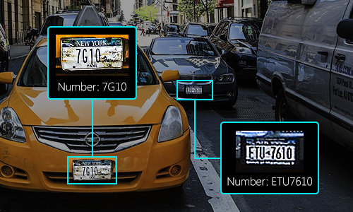
Image Processing
http://rnd.azoft.com/convolutional-neural-networks-object-detection/

Slide 3
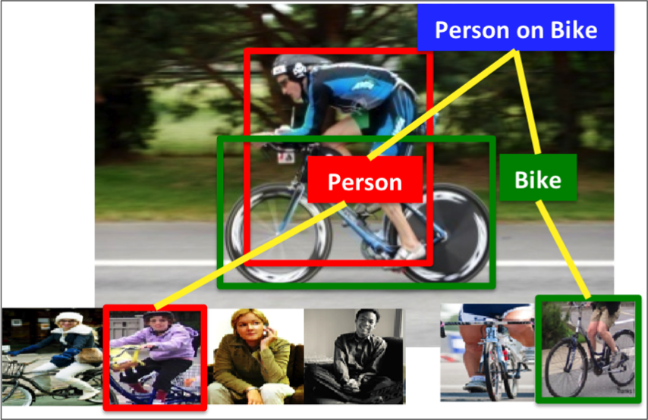
Image Processing
http://cs.stanford.edu/~taranlan/

Slide 4
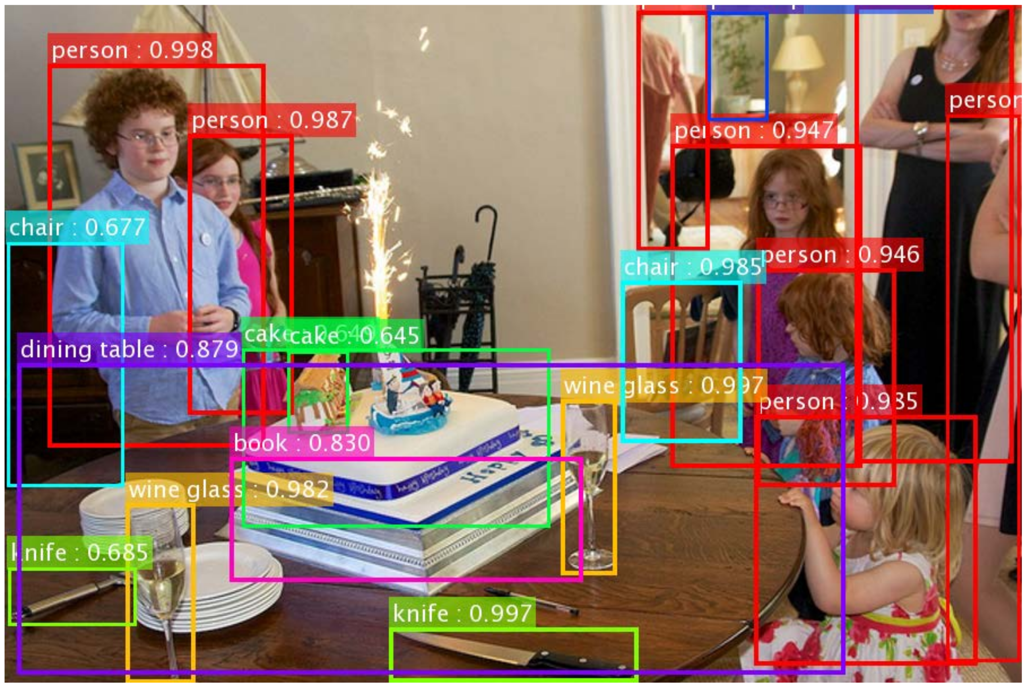
https://chaosmail.github.io/deeplearning/2016/10/22/intro-to-deep-learning-for-computer-vision/

Slide 5
Image Sampling
and
Quantization

Slide 6
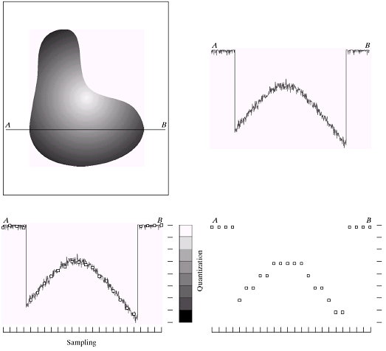
Image Sampling and Quantization

Slide 7
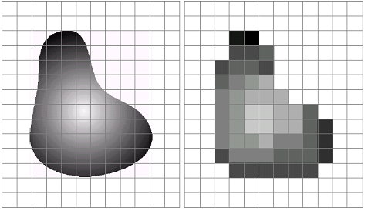
Image Sampling and Quantization
Sampling: digitizing the 2-dimensional spatial coordinate values
Quantization: digitizing the amplitude values (brightness level)

Slide 8
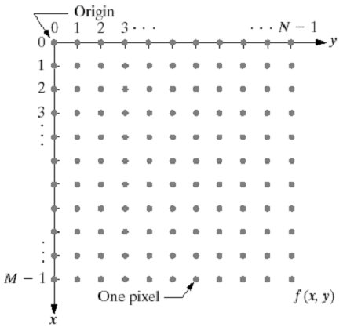
Representing Digital Images

Slide 9
Representing Digital Images--Examples
PGM file
PPM file
P2
320 240
255
200 215 25 …
55 25 25 …
25 55 255 …
P3
# Created by Paint Shop Pro 5
320 240
255
200 215 25 200 215 25 …
55 25 25 55 25 25 …
25 55 255 25 55 255 …
https://en.wikipedia.org/wiki/Netpbm#File_formats

Slide 10
Types of Image File Formats--Examples
Types of image file formats:
BMP : Microsoft Bitmap formal
JPEG : Joint Photographics Experts Group
PNG : Portable Network Graphics
TIFF : Tagged Image File Format
GIF : Graphics Interchange Format
HDF : Hierarchical Data Format
PCX : PC Paintbrush
…
10

Slide 11
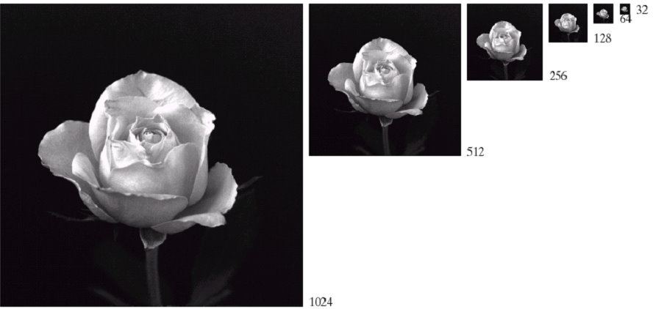
Spatial Resolution

Slide 12
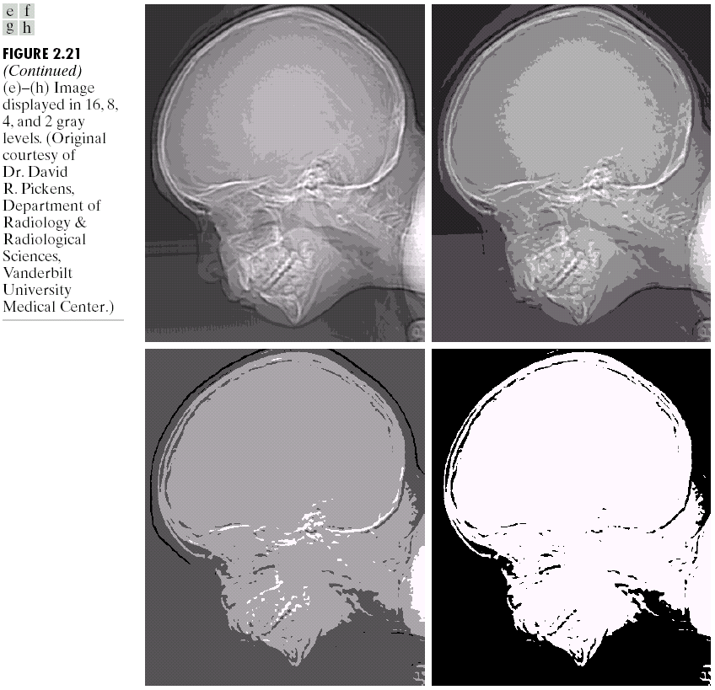
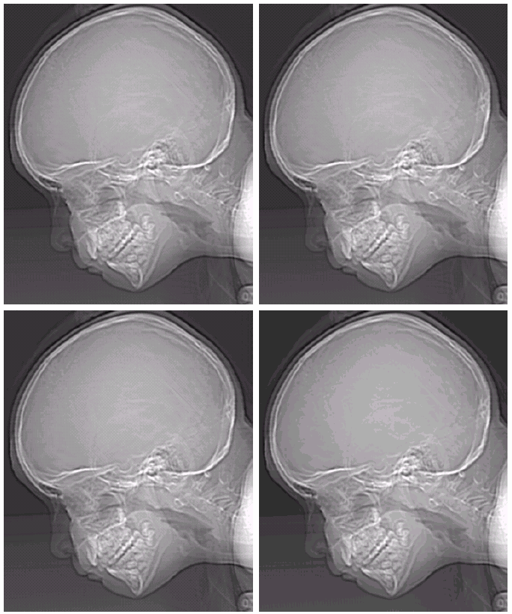
Gray-Level Resolution
256
128
16
8
64
32
4
2

Slide 13
Some Basic Relationships Between Pixels
Pixel
A pixel has a location (the spatial coordinate) and a value.
Connected component of S
The set of all pixels in S that are connected to a given pixel in S.
Region of an image
Contour of a region
Edge
Edge is a path of one or more pixels that separate two regions of significantly different gray levels.

Slide 14
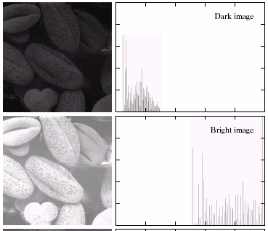
Histogram

Slide 15
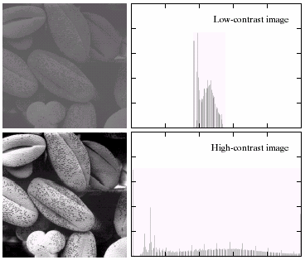
Histogram

Slide 16
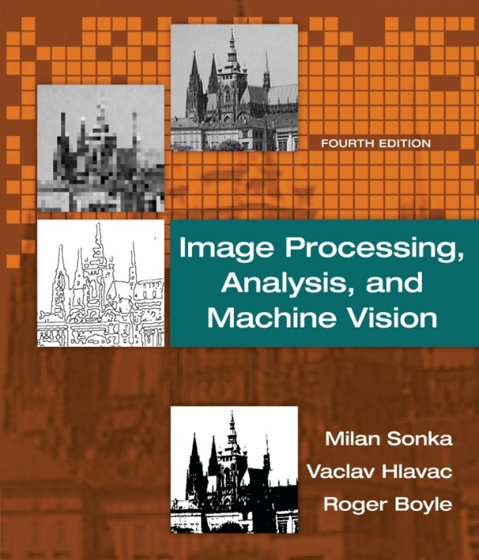
Textbook
Textbook
Image processing Analysis, and Machine Vision, 4th edition
Milan Sonka, Vaclav Hlavac, Roger Boyle
2015

Slide 17
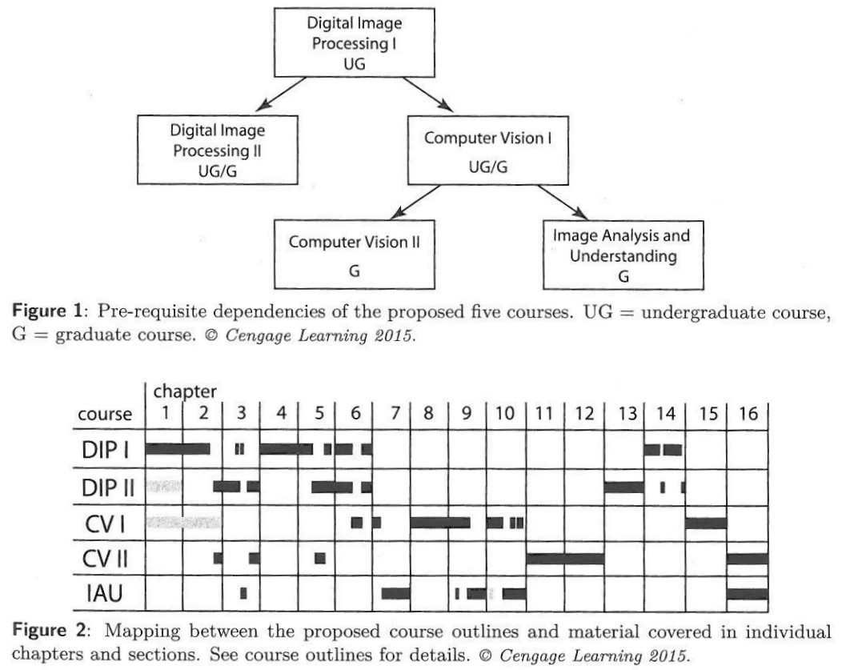

Slide 18
Outline
Chapter 1 Introduction
Chapter 2 The image, its representations and properties
Image digitization, digital image properties, color images, cameras
Chapter 3 The image, its mathematical and physical background
Linear integral transforms, images as stochastic processes, image formation physics
Chapter 4 Data structures for image analysis
Levels of image data representation, traditional image data structures, hierarchical data structures
Chapter 5 Image pre-processing
Pixel brightness transformations, geometric transformations, local pre-processing, image restoration
Chapter 6 Segmentation I
Thresholding, edge-based segmentation, region-based segmentation, matching, evaluation issues in segmentation

Slide 19
Assignment
Term Project Topics
Face region detection
Skin color detection
Vehicle detection
Obstacle detection
Road sign detection
Lane detection
Object detection…
（甲狀腺）

